Slide 1
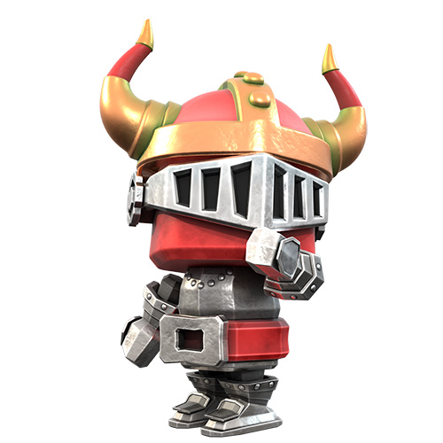
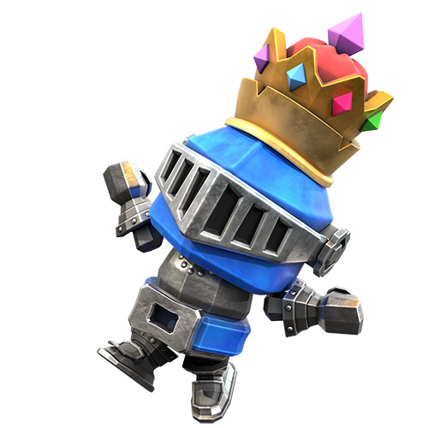
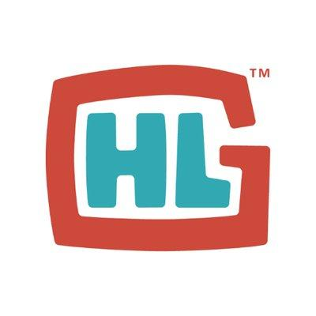
Hello Hyper Luminal!
Hi Stuart!
Hi Dan!

Slide 2
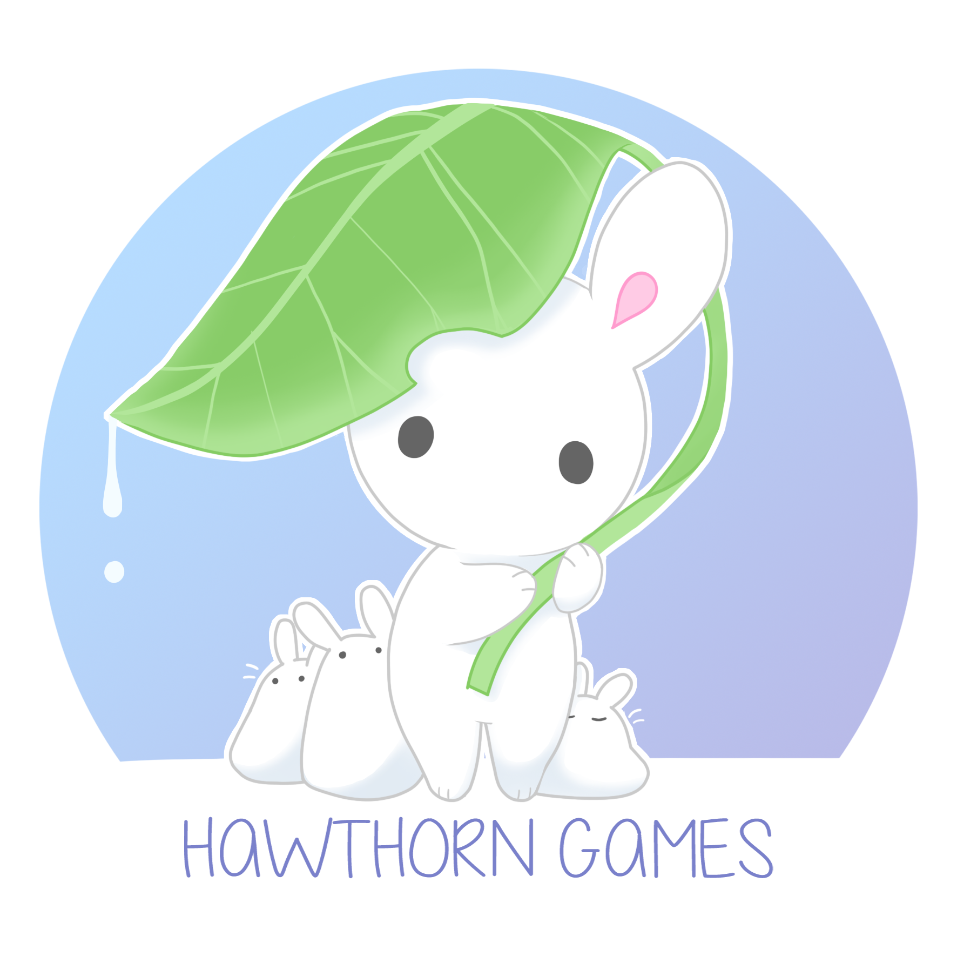
Who are we?
A group of passionate students with a strong desire to make awesome experiences that help players learn something new.
We came together through our collective love of games and the need to challenge ourselves, to make something we would be proud of!

Slide 3
NAME
Role
NAME
Role
NAME
Role
NAME
Role
NAME
Role
NAME
Role
NAME
Role
NAME
Role

Slide 4
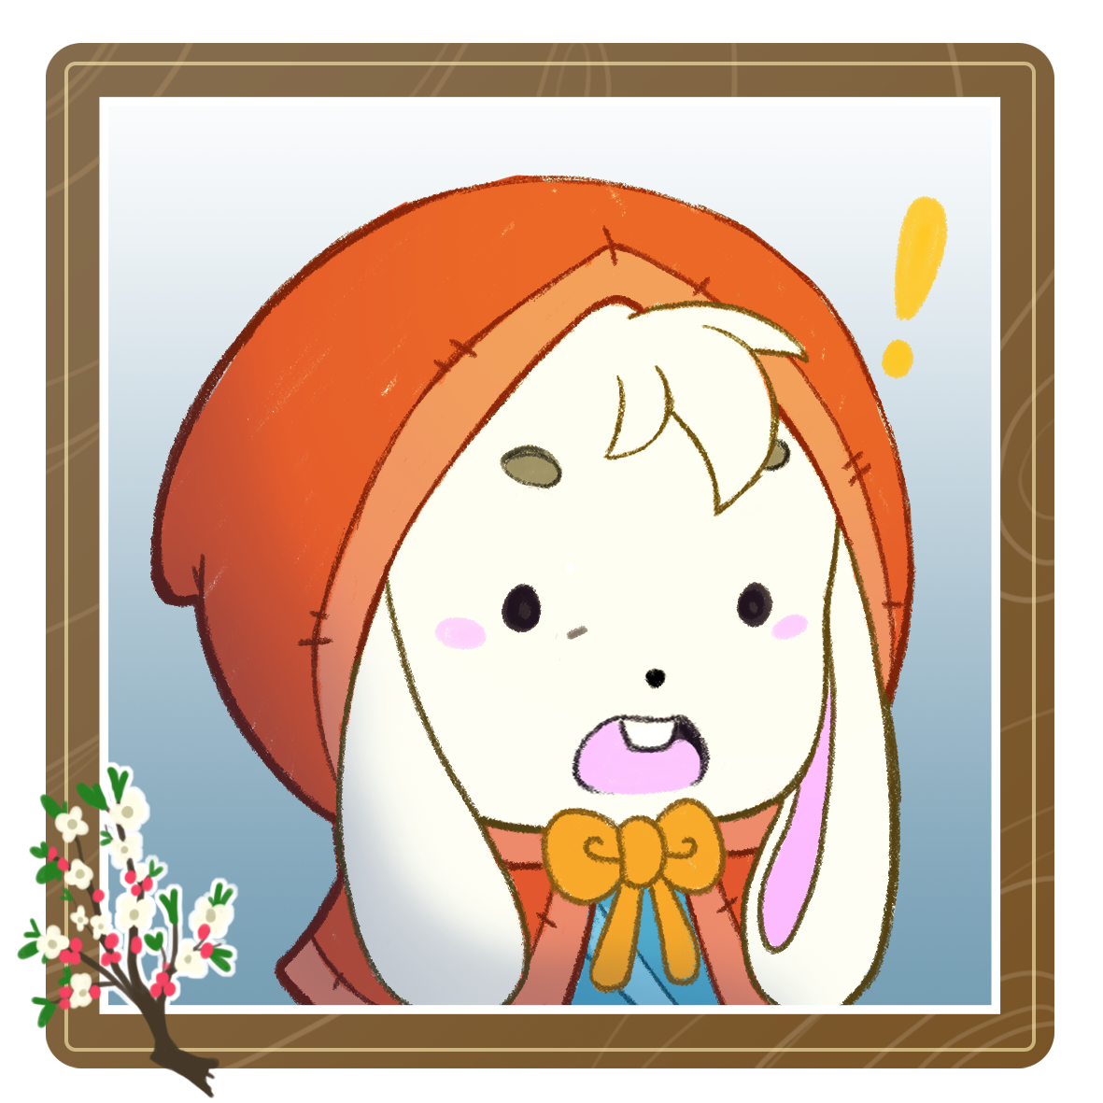
The Brief
Revolves around one main question
Can we make a game about game development, presenting it in a non-educational format?

Slide 5
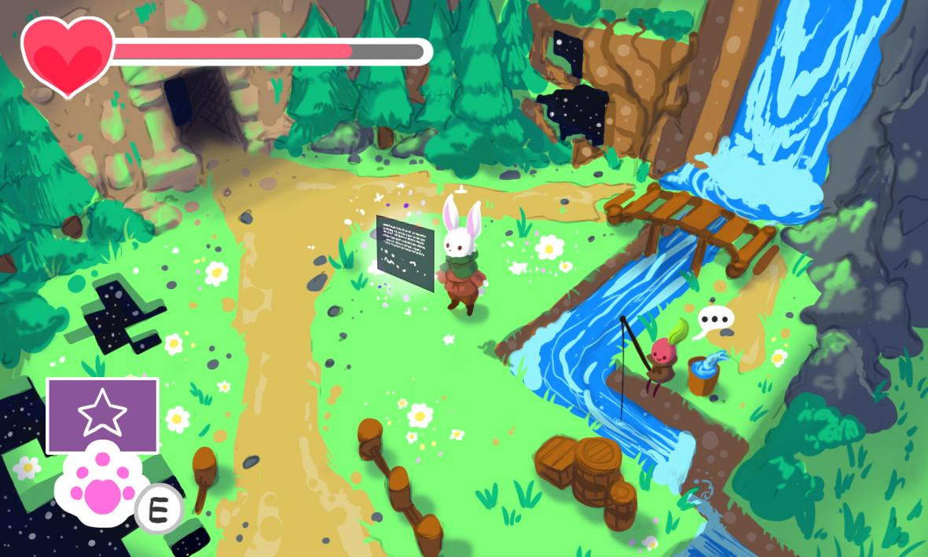
The Game
Play as a self-aware character in an unfinished game and try to fix the developer’s mess!

Slide 6
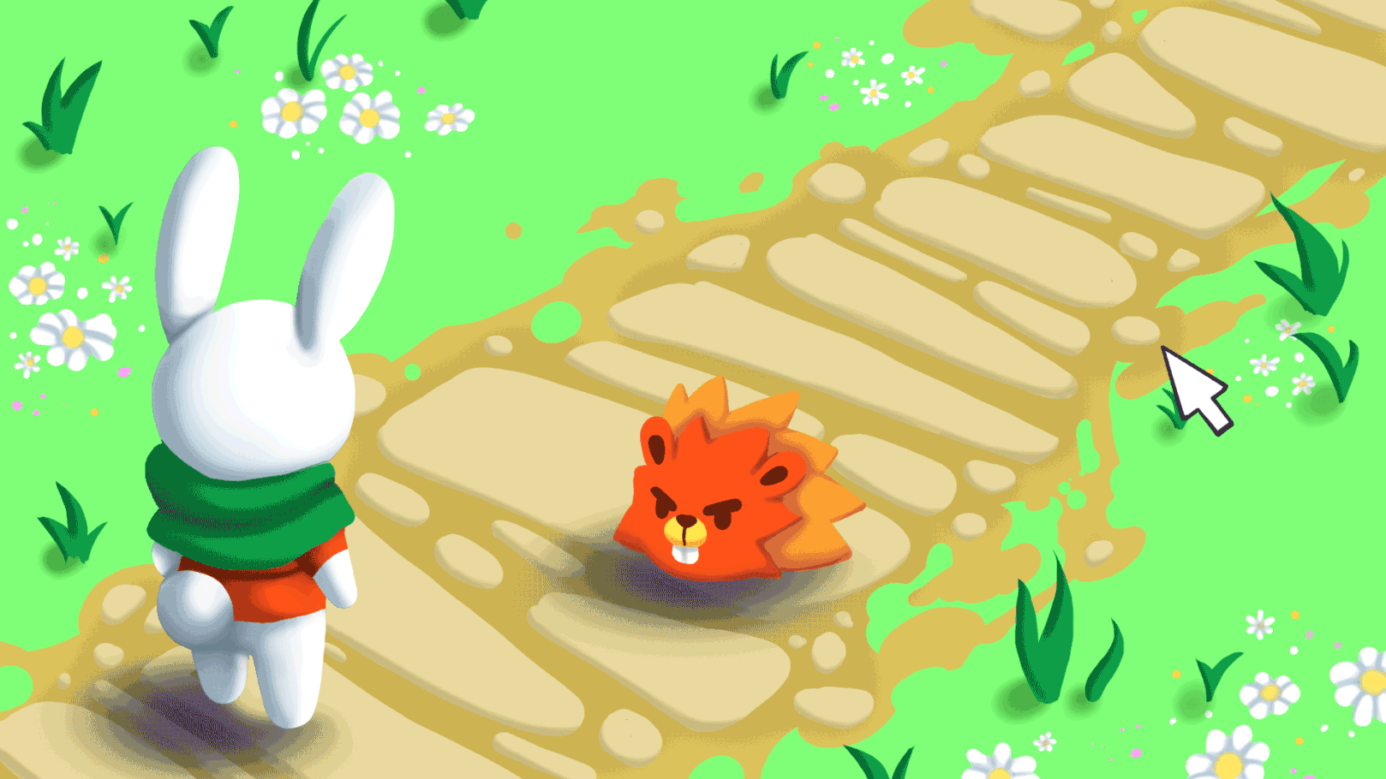
Logic Editing
The player is able to edit the behaviour of objects in the world with a simple visual scripting language inspired by Scratch and Rabbids Coding
Notes:
Logic Editing
The player will access elements in the world such as objects, enemies or items and “re-program” them using predefined blocks of “code” that they can scavenge from the environment in order to solve gameplay scenarios. The puzzles focus on expressive multi-solution logic design.

Slide 7
...with an adventure twist
We want to maintain an “adventure game” aesthetic throughout the experience.
The player is going to explore the world to find challenges, scavenge Code Blocks, unlock “editing permissions” for new objects and so on.
Notes:
Exploration
The player will explore the world to find new areas, new items, scavenge blocks of code and progress in the adventure.

Slide 8
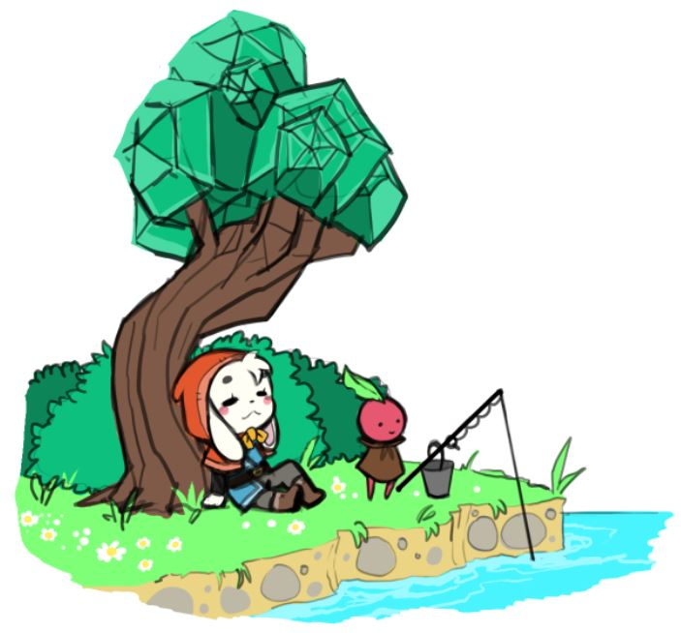
USPs Summary
Fulfill your role by playing as a self-aware adventurer in an interconnected world
Finish the game and turn it into a flawless masterpiece with the Logic Editing mechanic
Make friends with a diverse set of characters that inhabit the low-poly environments and save them from being deleted forever!

Slide 9
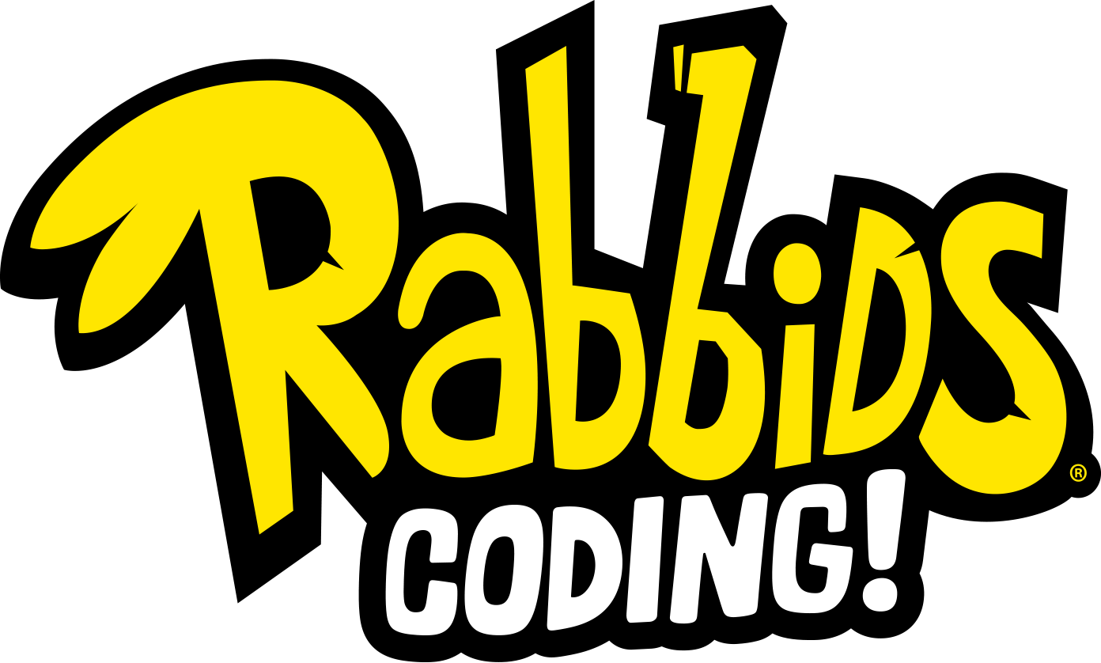
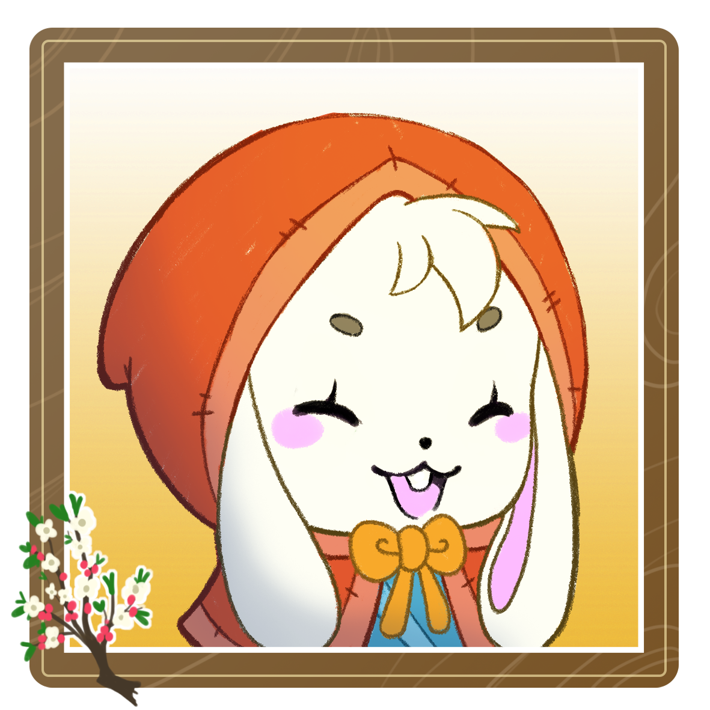
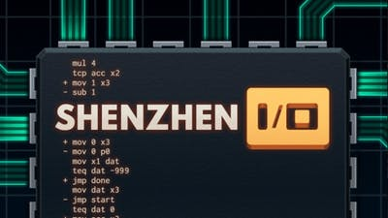
Target Market
Project Scrapped sits between the simplicity of Rabbids Coding and the depth of Zachatronic Games. We aim to resonate with young video-game players (12-18 Years Old) that enjoy puzzle games and are interested in game development by providing them an experience that engages their reasoning skills and logical thinking.
We are here!
Notes:
We are attempting to bridge the gap between narrative focused game development games such as “The beginners Guide” and mechanics focused programming games like “Rabbids Coding” and Zachatronics games by creating an experience that delivers both a heartfelt game development story while creating a system that elicits the experience of game development in-engine

Slide 10
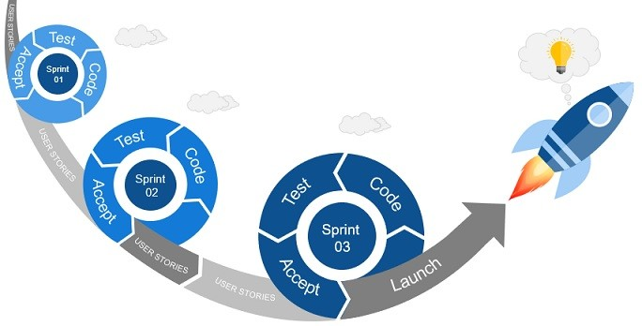
Development Approach

Slide 11
Product Roadmap
FP
A
B
GM
DARE
First Playable – Week 5
Alpha - Week 10
Beta – Week 14
Gold Master - Week 16
We plan to have a solid proof of concept by week 5
We want to be feature complete by Week 10
Major content should be final in Week 13
The final submission is on Week 16!

Slide 12
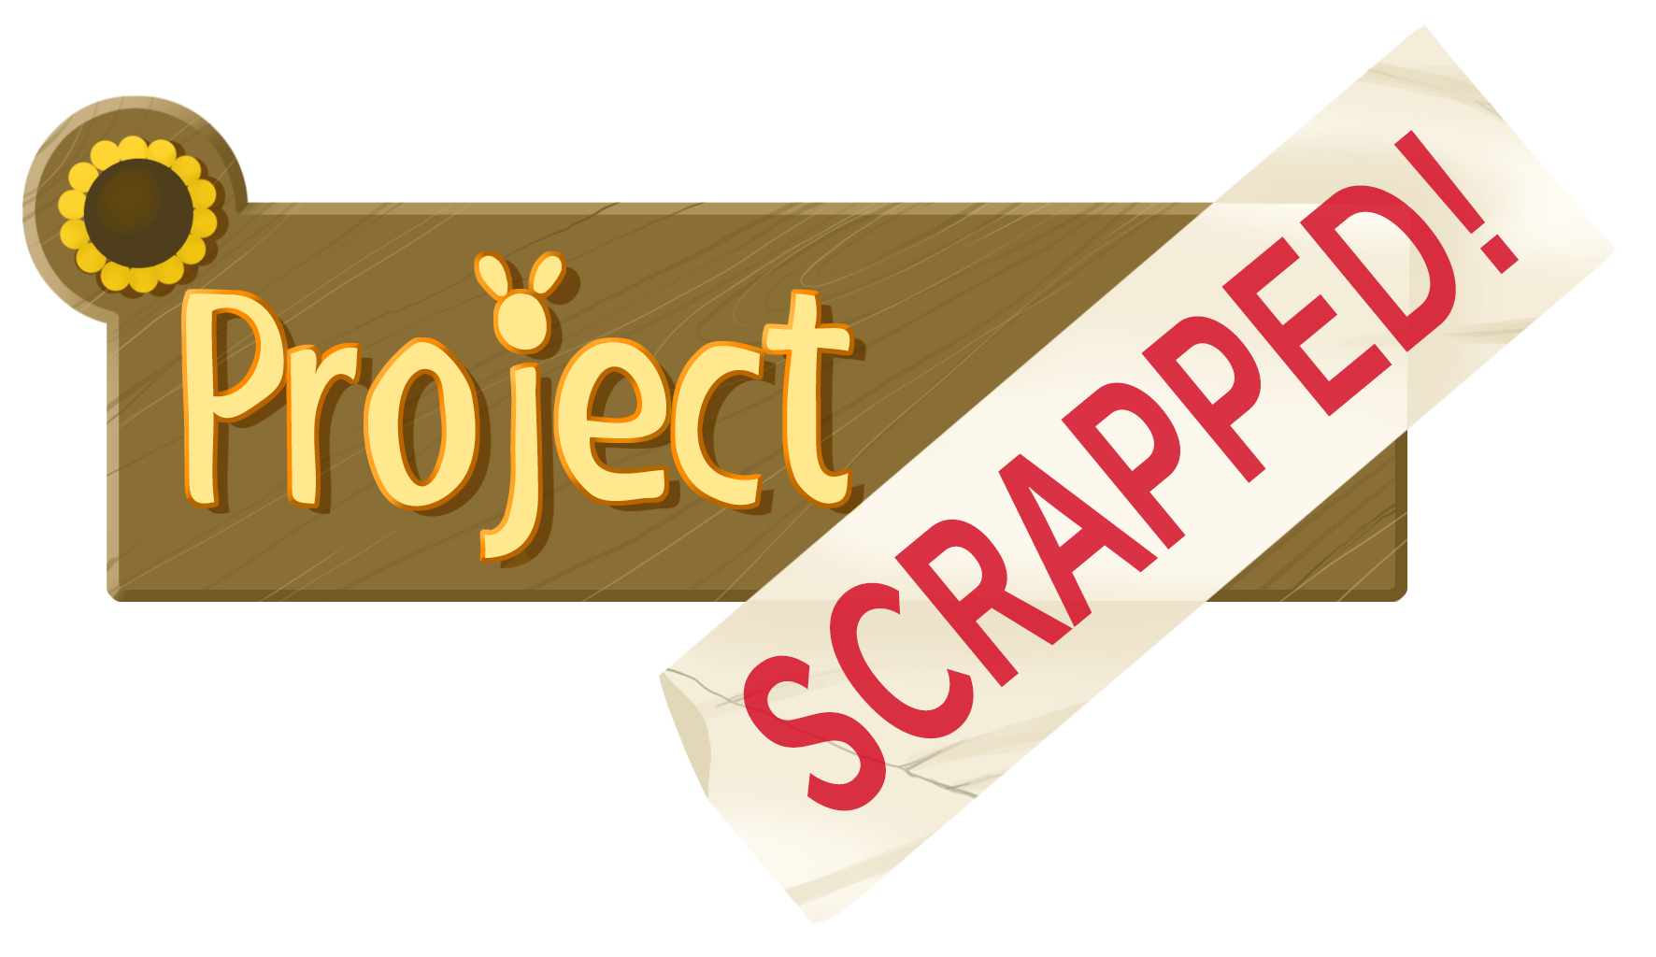
Thank You!
Hawthorn Games
from

